Slide 1

Java Programming Essentials: A Comprehensive Journey into Core Java and Beyond
- Bharath Ashok

Slide 2

Day 12

Slide 3
Day 12: Agenda
Queue
Comparable and Comparator
Iterators
Concurrent Modification Exceptions
Fail-safe and Fail-Fast Iterators
Hands-on
Assignments
Interview Questions

Slide 4
Collection Framework

Slide 5
Queues

Slide 6
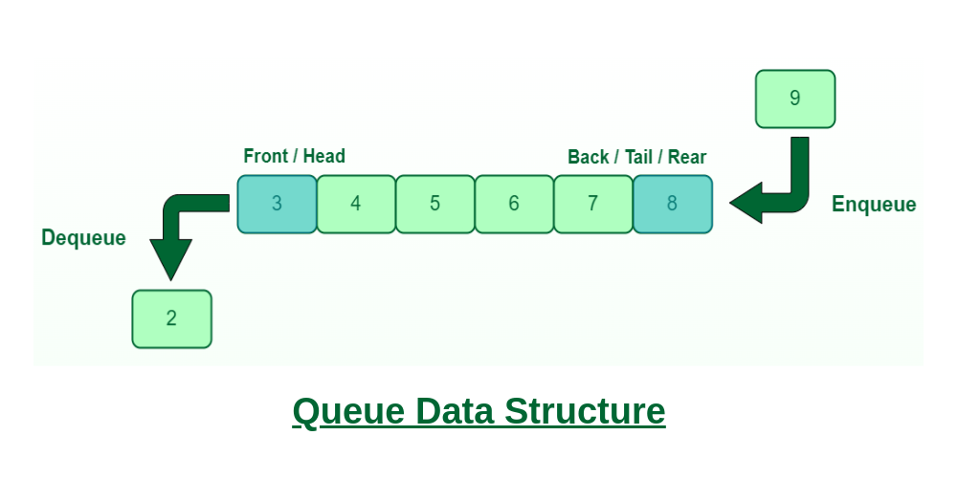
Introduction to Queues
Queues are a fundamental data structure in programming.
They follow the First-In-First-Out (FIFO) principle, where the first element added is the first one to be removed.
Queues are used to manage elements or tasks in a sequence, ensuring fairness in processing.

Slide 7
Java.util.Queue
Key Characteristics:
First-In-First-Out (FIFO):
The primary characteristic of a queue is that the element that is added first will be the first to be removed (hence, the term "first-in, first-out").
Operations:
Common operations on a queue include adding elements to the back (enqueue) and removing elements from the front (dequeue). Additionally, queues often provide methods to peek at the front element without removing it and to check if the queue is empty.
Interfaces:
In the Java Collections Framework, the Queue interface is the main interface that defines the operations of a queue. It extends the Collection interface and adds methods specific to queues.
Implementations:
LinkedList: A double-ended queue (Deque) that can be used as a queue.
ArrayDeque: A resizable-array implementation of a queue and deque.
PriorityQueue: A priority queue based on a heap data structure.
Blocking Queues: In addition to the basic Queue interface, Java also provides the BlockingQueue interface, which is an extension that includes methods for handling concurrency.
Blocking queues are designed to support multiple threads safely adding and removing elements.

Slide 8
Common Queue Implementations
LinkedList:
Unbounded queue implementation.
Offers flexibility and dynamic growth.
Commonly used for general-purpose queues.
PriorityQueue:
Orders elements based on priority (natural order or custom comparator).
Ideal for scenarios where priority matters.
ArrayBlockingQueue:
Bounded queue backed by an array.
Provides thread-safety.
Suitable for managing limited resources or concurrent tasks.

Slide 9
Queue Hands-on

Slide 10
Comparable Interface

Slide 11
Java.util.Comparable
The Comparable interface in Java is used to define the natural ordering of objects.
It contains a single method, compareTo(), that we need to implement in our class.
The compareTo() method returns a negative integer, zero, or a positive integer, depending on whether the current object is less than, equal to, or greater than the provided object.
compareTo() method takes only one argument.
Examples: Collections.sort()

Slide 12
Comparable Hands-on

Slide 13
Comparator Interface

Slide 14
Java.util.Comparator
The Comparator interface in Java is used to define custom comparison logic separate from the class being compared.
It's particularly useful when we want to sort objects in multiple ways or when we can't modify the class we're trying to sort.
Examples: TreeSet() and Collections.sort()

Slide 15
Comparable Hands-on

Slide 16
Traversing Iterable Collections

Slide 17
Traversing Collections
Using For-Each Loop (Enhanced for Loop): This loop provides a concise way to iterate over collections that implement the Iterable interface, such as lists and sets. It simplifies the process of iterating and accessing elements.
Using Iterator: The Iterator interface provides a way to traverse any collection that implements it. It allows you to remove elements during traversal, which is not possible with the for-each loop.
Using ListIterator: This is a specialized iterator for lists that allows bidirectional traversal (forward and backward) and modification of elements.
Using Streams: Introduced in Java 8, streams provide a functional approach to traversing and processing collections. They allow you to apply various operations such as filtering, mappingon the collection elements.

Slide 18
Traversing Hands-On

Slide 19
Fail-Safe and Fail-Fast Iterators

Slide 20
Fail-Fast Iterators
Fail-fast iterators are designed to quickly detect any concurrent modifications and throw a ConcurrentModificationException to signal that the underlying collection has been modified while being iterated.
They provide immediate feedback about the inconsistency in the collection's state
Real-time scenario example for fail-safe iterators:
Imagine we are developing a banking application with multiple threads. One thread is iterating over a list of customer transactions while another thread is processing deposits and withdrawals concurrently.
In this case, if a fail-fast iterator is used, any concurrent modification (such as adding a new transaction) will lead to a ConcurrentModificationException, indicating that the collection's structure has changed unexpectedly.

Slide 21
Fail-Safe Iterators
Fail-safe iterators are designed to work safely in the presence of concurrent modifications to the underlying collection.
Instead of throwing a ConcurrentModificationException, fail-safe iterators create a copy of the collection at the beginning of iteration and iterate over the copy.
This means that they won't reflect changes made after the iterator was created
Real-time scenario example for fail-safe iterators:
Suppose we have a multi-threaded application where one thread is iterating over a collection, and another thread is modifying it concurrently.
In this scenario, using fail-safe iterators prevents the iterator from throwing exceptions, and the iteration will continue over the original collection without reflecting the concurrent modifications.

Slide 22
Fail-Safe and Fail-Fast Iterators Hands-on

Slide 23
Interview Questions

Slide 24
Queue Interview Questions
What is the purpose of the Queue interface in Java?
Explain the main principle behind a Queue data structure.
What are the key methods provided by the Queue interface?
Differentiate between the add() and offer() methods in the Queue interface.
What does the remove() method do? What exception does it throw?
How does the poll() method differ from the remove() method?
What is the purpose of the element() method? What exception does it throw?
Explain the use case for the peek() method.
Can you name some classes in Java that implement the Queue interface?
Describe the characteristics of a PriorityQueue.
Which package contains the Queue interface in Java?

Slide 25
Queue Interview Questions
What are the fundamental differences between a stack and a queue?
How can you iterate through the elements of a Queue?
Explain a real-world scenario where using a Queue could be beneficial.
What happens if you try to add a null element using the add() method in a Queue?
In what situations might you choose to use an ArrayDeque over a LinkedList as an implementation of the Queue interface?
How can you implement a priority-based behavior using the Queue interface?
Describe the scenario when you would use the PriorityQueue class instead of other implementations of the Queue interface.
What is the time complexity of the add(), remove(), peek(), and size() methods in most Queue implementations?
Can a Queue be used as a replacement for a regular List? Why or why not?
What is the significance of the Deque interface, and how does it relate to the Queue interface?
How does the Java Queue interface handle thread safety? Are its implementations generally thread-safe?
Discuss a situation where you might need to implement a custom Queue class that adheres to a specific behavior not covered by existing implementations.

Slide 26
Comparable Interview Questions
What is the purpose of the Comparable interface in Java?
How does the Comparable interface enable natural ordering of objects?
Can you provide an example of a class that implements the Comparable interface? How would you use it to sort a collection?
What is the compareTo() method? How is it used within the Comparable interface?
How can you sort an array or a collection of custom objects that implement the Comparable interface?
What happens if you attempt to sort a collection of objects that do not implement the Comparable interface?
Explain the contract that classes must follow when implementing the Comparable interface.
In which package is the Comparable interface located?
How would you implement reverse ordering for a class that already implements the Comparable interface?

Slide 27
Comparator Interview Questions
What is the purpose of the Comparator interface in Java?
How does the Comparator interface enable custom ordering of objects?
Provide an example of a class that implements the Comparator interface. How would you use it to sort a collection?
What is the compare() method in the Comparator interface? How is it used for sorting?
How can you sort a collection of objects using a custom Comparator?
Explain the difference between using the Comparable interface and the Comparator interface for sorting.
How would you implement reverse ordering using a Comparator?
In which package is the Comparator interface located?
Can a single class implement both the Comparable and Comparator interfaces? If so, how would they work together?
When might you prefer using a Comparator over the Comparable interface for sorting?

Slide 28
Fail-Fast Iterators Interview Questions
What is the concept of "fail-fast" in Java iterators?
How do fail-fast iterators detect concurrent modification?
When does a fail-fast iterator throw a ConcurrentModificationException?
Explain why fail-fast iterators are considered proactive in detecting modification issues.
What is the relationship between fail-fast behavior and the Iterator interface?
How can you handle the ConcurrentModificationException thrown by a fail-fast iterator?
Mention a class in Java's standard library that provides fail-fast iterators.
What programming scenarios are best suited for fail-fast iterators?
Are fail-fast iterators thread-safe? Why or why not?
How does fail-fast behavior impact the performance of applications?

Slide 29
Fail-Safe Iterators Interview Questions
What does "fail-safe" mean in the context of Java iterators?
How do fail-safe iterators handle concurrent modification?
When using a fail-safe iterator, will it throw a ConcurrentModificationException?
What is the key difference in behavior between fail-fast and fail-safe iterators?
Mention a class in Java's standard library that provides fail-safe iterators.
How do fail-safe iterators achieve their safety in the presence of modifications?
In what scenarios would you prefer using fail-safe iterators?
Are fail-safe iterators always more efficient than fail-fast iterators? Explain.
Can you think of any drawbacks or trade-offs associated with fail-safe iterators?
How do fail-safe iterators impact the overall application performance?

Slide 30
Iterators Interview Questions
What is the purpose of an Iterator in Java?
Explain the basic usage of the Iterator interface.
What is the difference between an Iterator and a ListIterator?
Describe the characteristics of a ListIterator. What additional functionality does it provide compared to a regular Iterator?
What is an enhanced for loop (for-each loop) in Java? How does it relate to iterators?
Explain the concept of a fail-fast iterator. How does it detect concurrent modifications?
What is the difference between fail-fast and fail-safe iterators?
In which classes would you find an Iterator implementation in the Java Collections framework?
How can you iterate over the elements of a Map using iterators? What are the limitations of this approach?
Discuss the role of the Spliterator interface in Java. How does it differ from the traditional Iterator?
What is the use case for the Enumeration interface in Java? How does it compare to the Iterator interface?
Explain the concept of a DequeIterator. In which classes can you find this type of iterator in Java?
How does the ListIterator interface handle both forward and backward iteration through a list?
What is the significance of the hasNext() and next() methods in the Iterator interface?
In which Java collections can you use a TreeIterator? How does it maintain ordering of elements?

Slide 31
Assignments

Slide 32
Queue Assignments
Assignment 1: Order Processing System
Design an order processing system for an e-commerce platform. Implement classes for Order and OrderQueue. Each Order object should have a unique order ID and order details. The OrderQueue class should have methods to add new orders, process orders in the order they were received, and display the current queue of orders.
Assignment 2: Printer Queue
Create a simplified printer queue simulation. Implement classes for PrintJob and PrinterQueue. Each PrintJob object should have a unique job ID and the number of pages to print. The PrinterQueue class should have methods to add new print jobs, process print jobs in the order they were received, and display the current queue of print jobs.
Assignment 3: Call Center Simulation
Simulate a call center environment using a Queue. Implement classes for Call and CallQueue. Each Call object should have a unique call ID and call details. The CallQueue class should have methods to add incoming calls, process calls in the order they were received, and display the current queue of calls.
Assignment 4: Customer Support Queue
Design a customer support ticketing system using a Queue. Implement classes for Ticket and TicketQueue, where each Ticket object represents a customer support ticket with a unique ID and a description. The TicketQueue class should have methods to add new tickets, remove and process tickets in the order they were added, and display the current queue of tickets.

Slide 33
Comparator and Comparable
Assignment 1: Student Sorting
Create a class named Student with attributes name, age, and score. Implement the Comparable interface in the Student class to allow sorting based on the student's score in ascending order. Then, create a custom Comparator that sorts students based on their age in descending order. Finally, create a list of students and demonstrate both natural ordering and custom ordering using Comparator.
Assignment 2: Employee Sorting
Design an Employee class with attributes id, name, and salary. Implement the Comparable interface in the Employee class to allow sorting based on employee ID in ascending order. Additionally, create a Comparator that sorts employees based on their salary in descending order. Create an array of employees and showcase both types of sorting.
Assignment 3: Online Store Products
Develop a Product class with attributes productId, name, and price. Implement the Comparable interface within the Product class to enable sorting based on product name in alphabetical order. Create a custom Comparator to sort products by price in ascending order. Construct a list of products and demonstrate both natural ordering and custom ordering using Comparator.
Assignment 4: Book Library
Construct a Book class with attributes title, author, and publicationYear. Implement the Comparable interface in the Book class to allow sorting based on the publication year in ascending order. Design a Comparator that sorts books alphabetically by author's name. Build an ArrayList of books and illustrate both types of sorting.

Slide 34
Q&A

